Slide 1
To Increase the Sale and Reduce the Manufacturing Cost of a Firm of Bricks Industry
Name: Anupam kumar jha
Roll no.: 21f1004905

Slide 2
Table of Content
Organization Details
Problem Statement
Analysis Process
Results and Findings
Recommendation

Slide 3
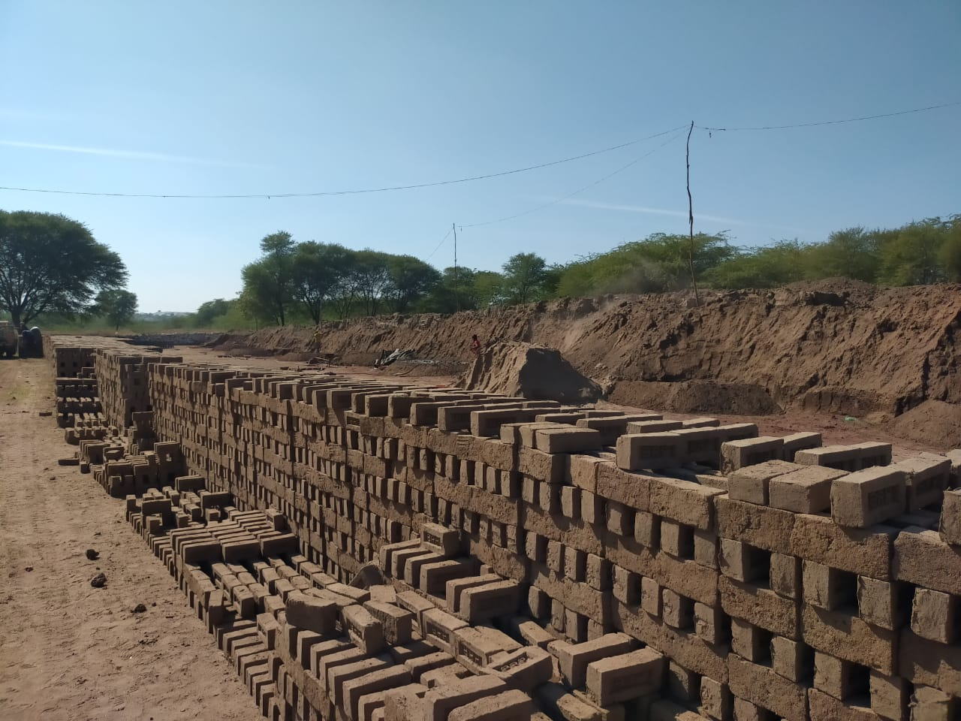
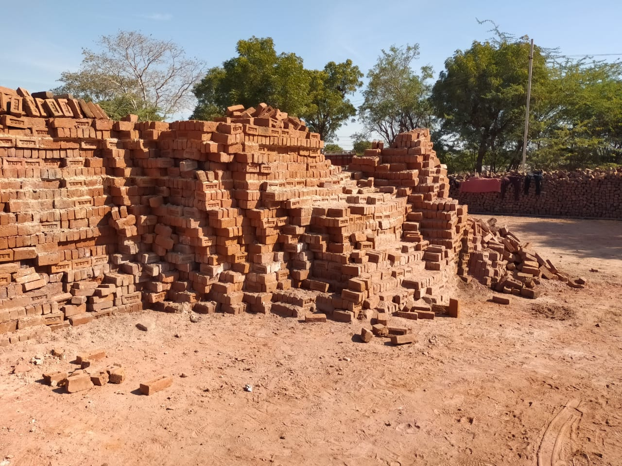
Organization Background
Name: Ramdev Bricks Manufacturers.
Established in 1992
Located in Amet, Rajsamand(Rajasthan), India
Manufactures and sells 10,00,000 bricks annually
Three qualities of bricks sold at varying prices based on quality
Employs 7-8 workers
Business established by Mr. Boli Ram Prajapat & Mrs. Rukma Devi and now run by their son Mr. Rahul Prajapat
Contact number for Mr. Rahul Prajapat: 7891414306

Slide 4
Problem Statement
Increase the sale of Ramdev Bricks Manufacturers: Ramdev Bricks Manufacturer is struggling to capture the increasing demand. They are only able to cover 3.33% of total market. Their current capacity of 10,00,000 bricks annually falls significantly short of the industry demand of 3,00,00,000 bricks annually within a 50 km radius. Increasing market share could lead to higher net profits.
Reduce the Manufacturing Cost: The manufacturing cost of the bricks is currently high at ₹4/brick, and the selling price cannot go beyond ₹5.5/brick due to the competitive market. If the firm can reduce their costs, they can increase their margin and potentially sell bricks at a lower price, increasing their market volume and ultimately net profit.

Slide 5
Analysis Process
Book-Keeping To Excel
Data Cleaning
Sales data merged on monthly basis
Missing values imputed with mean of daily sales data
Rally data separated by unit and type
Coal and clay data extracted from different vendors
Other costs cleaned with owner's help
Descriptive Statistics
Measures of central tendency and dispersion
Summary of dataset

Slide 6
Analysis Process(Cont.)
Listen to Data
Line-chart for time-series data
Pie-chart for percentage contribution
Bar-chart for comparison
Interpretation of Results and Findings
Applied knowledge of industry and market situation
Cross-checked with owner and internet
Finding Solutions
Recommendations for problems
Impact on problems and overall impact on business
Challenges to apply these solutions

Slide 7
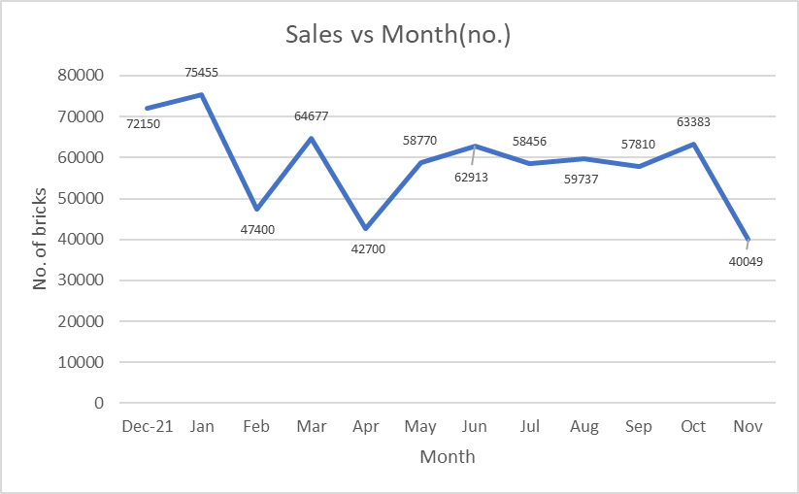
Results and Findings
Sales Data:
Fluctuating sales data with no clear trend
Sudden increase in sales in one month, followed by a drop in another month.
Smooth sales data during Jun 22 – Sep 22
Lowest sale in Nov 22 and highest in Jan 22
2. Manufacturing Data:
Rally's data: 2 types of rallies bought with different prices and quantities
Wood's data: 5420 Kg of wood used costing ₹18970

Slide 8
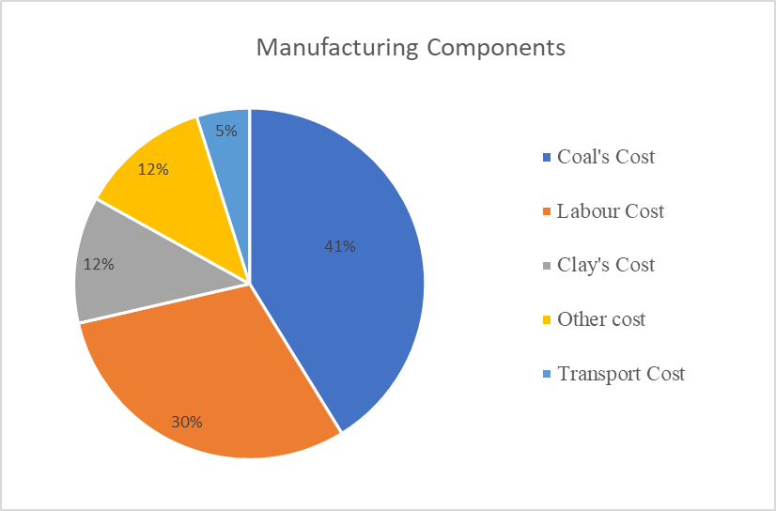
Results and Findings(Cont.)
Digging data: 69 hours of digging costing ₹69000
Clay's data: 385 trips bought from 3 vendors with different prices and quantities, totaling ₹3,20,800
Coal's data: costliest raw material with upward trend in cost from Dec.21 to Mar. 22.
Other cost: labor cost, electricity cost, cleaning cost, transportation cost, lease cost, loading cost
Pie chart showing the contribution of each cost component to the total manufacturing cost: coal (41%), labor (30%), clay (12%), transportation (5%), and other cost (12%)

Slide 9
Recommendations
Reducing clay cost
Reducing coal cost
Reducing labor cost
Maintain data properly
Find Contractors
Expand the business

Slide 10
Thank you

